Slide 1
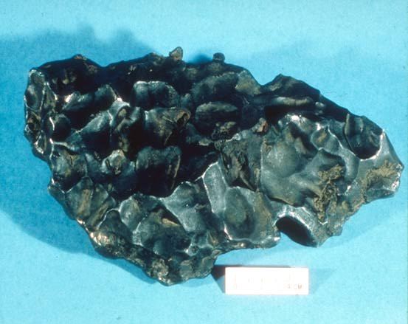
Lecture 15: Small Solar System Bodies
Claire Max
May 27, 2014
Astro 18: Planets and Planetary Systems
UC Santa Cruz

Slide 2
Outline of lecture
Asteroids
Pluto and Charon
Comets
Meteorites
Cosmic Collisions

Slide 3
First, some definitions
Asteroid: a rocky leftover planetesimal orbiting the Sun
Comet: an icy leftover planetesimal orbiting the Sun (regardless of whether it has a tail!)
Meteor: a flash of light in the sky caused by a particle or chunk of rock entering the atmosphere. May come from comet or asteroid.
Meteorite: any piece of rock that fell to the ground from space, whether from an asteroid, comet, or even from another planet

Slide 4
The Main Points, part 1
Asteroids
Failed planetesimals in outer Solar System
Fairly circular orbits
Mostly in “Kuiper Belt” beyond Neptune
Pluto and Charon
Similar to Kuiper Belt asteroids in many ways
Comets
Highly elliptical orbits
“Dirty snowballs” – agglomerations of rock and ice
Born in “Oort Cloud” that surrounds Solar System

Slide 5
The Main Points, part 2
Meteorites
Some are identifiable pieces of the Moon, Mars, or Vesta; most are pieces of asteroids
Broken off their parent bodies 10’s to 100’s of million years ago (“recently”)
Oldest meteorites contain unprocessed material from when the Solar System formed
Cosmic Collisions
Major role in evolution of Solar System, Earth
Significant collision with s Near Earth Objects is not improbable today

Slide 6
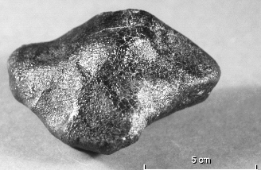
Asteroids as seen from Earth
Vesta (525 km)
Keck Tel. Adaptive Optics.
Movie in spectral line of pyroxene.
A piece of Vesta landed on Earth as a meteorite!
Made almost entirely of pyroxene.

Slide 7
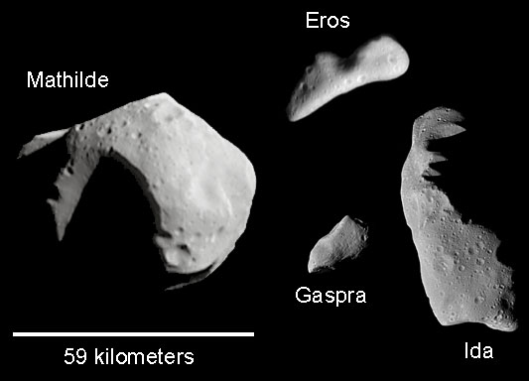
Some asteroids photographed by spacecraft (up close)

Slide 8
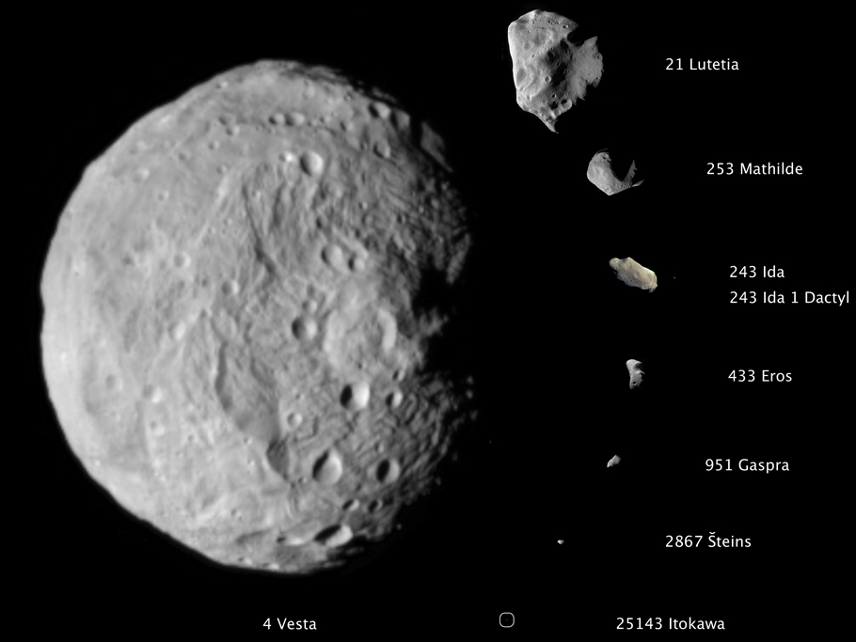
Asteroids as seen from space
Vesta was reclassified as a “dwarf planet”

Slide 9
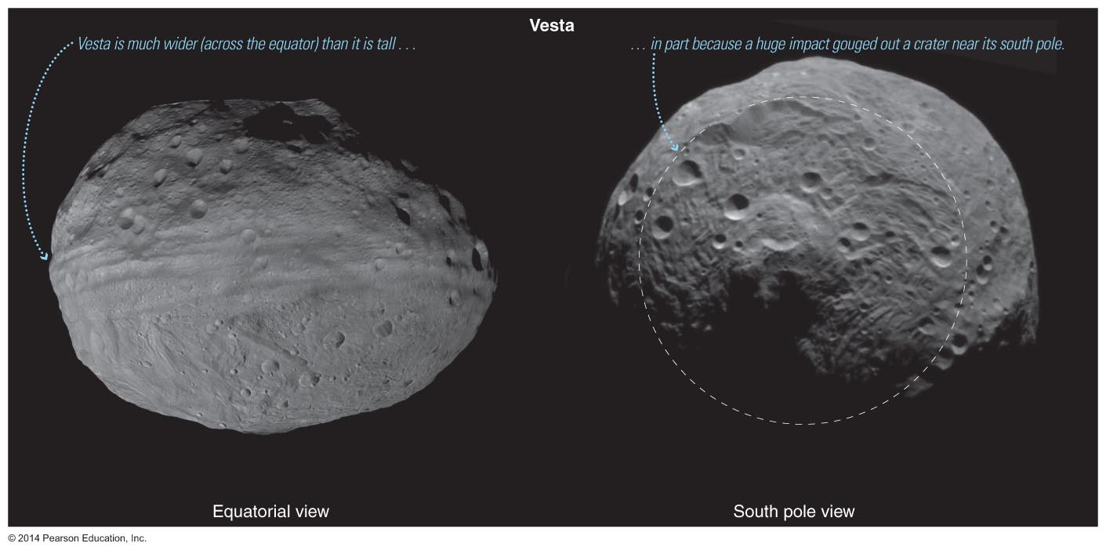
Vesta as seen by the Dawn Spacecraft

Slide 10
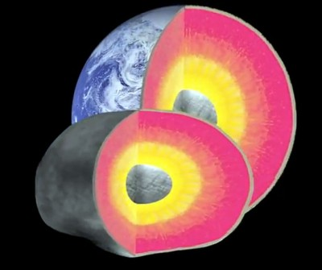
Vesta has differentiated interior

Slide 11
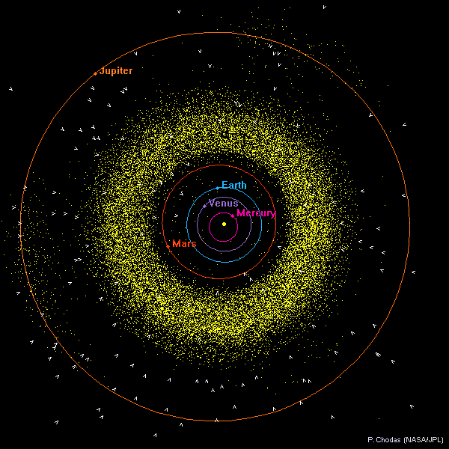
The asteroid belt: actual positions
Between Mars and Jupiter orbits
“Should” be a planet there
Jupiter’s gravity perturbations probably prevented coalescence
Also “Trojan Asteroids” 60 deg ahead of and behind Jupiter

Slide 12
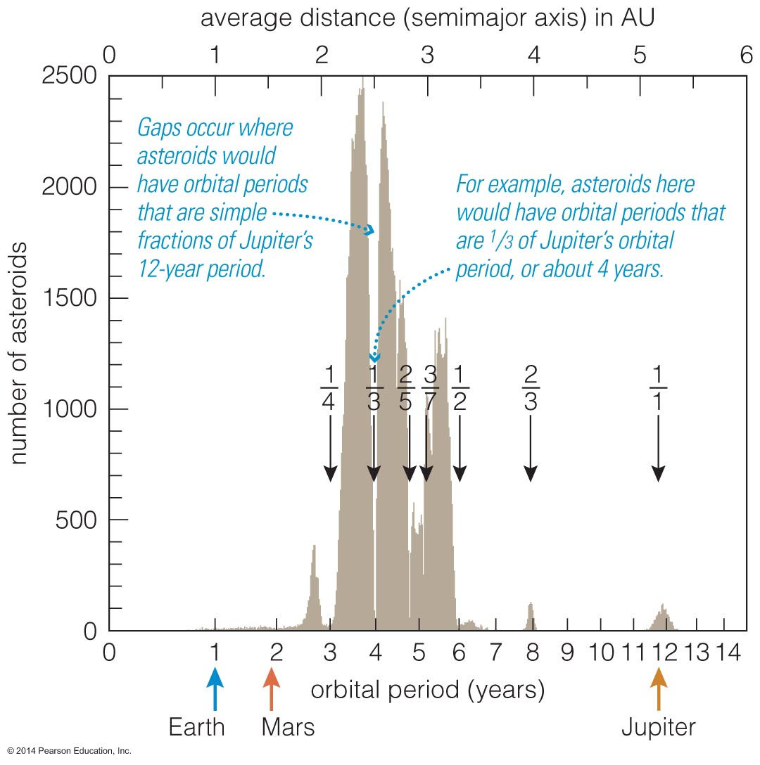
Orbital Resonances
Asteroids in orbital resonance with Jupiter experience periodic nudges.
Eventually, those nudges move asteroids out of resonant orbits, leaving gaps in the asteroid belt.

Slide 13
How did asteroid belt get there in the first place?
Current asteroid belt has total mass 5 x 10⁻⁴ x mass of Earth
Several lines of evidence suggest that the original asteroid belt was 100 - 1000 times more massive
But once Jupiter fully formed (after ~ 10 million years), its gravity strongly perturbed the orbits of almost all the asteroids
Most of them got nudged into highly eccentric orbits, from which they either leave the Solar System or head inwards toward the Sun
A fraction of the asteroids headed inwards may have hit the early Earth!

Slide 14
Asteroids are quite far apart (not like in Star Wars)
About 100,000 asteroids larger than 1 km
Not much mass: if gathered in a sphere, they would make a body less than 1000 km in diameter
Mean distance between asteroids is several million km!
If you were on an asteroid and looked up, you would see at most one other asteroid with your naked eye

Slide 15
Finding asteroids: they move fast with respect to the stars

Slide 16
ConcepTest
We've seen that many asteroids look like lumpy potatoes (very irregular shapes).
But some, such as Vesta, are pretty round.
What physical properties could cause some asteroids to be lumpy and some to be round?

Slide 17
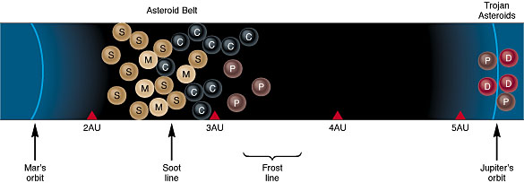
Asteroid categories and characteristics
Can categorize asteroids by albedo (reflectance)
Dark (low reflectance): C (carbon)
Medium reflectance: M (metallic)
High reflectance: S (silicates, rock)
Meteorites hitting Earth have same categories!
Categories correlate with distance from Sun

Slide 18
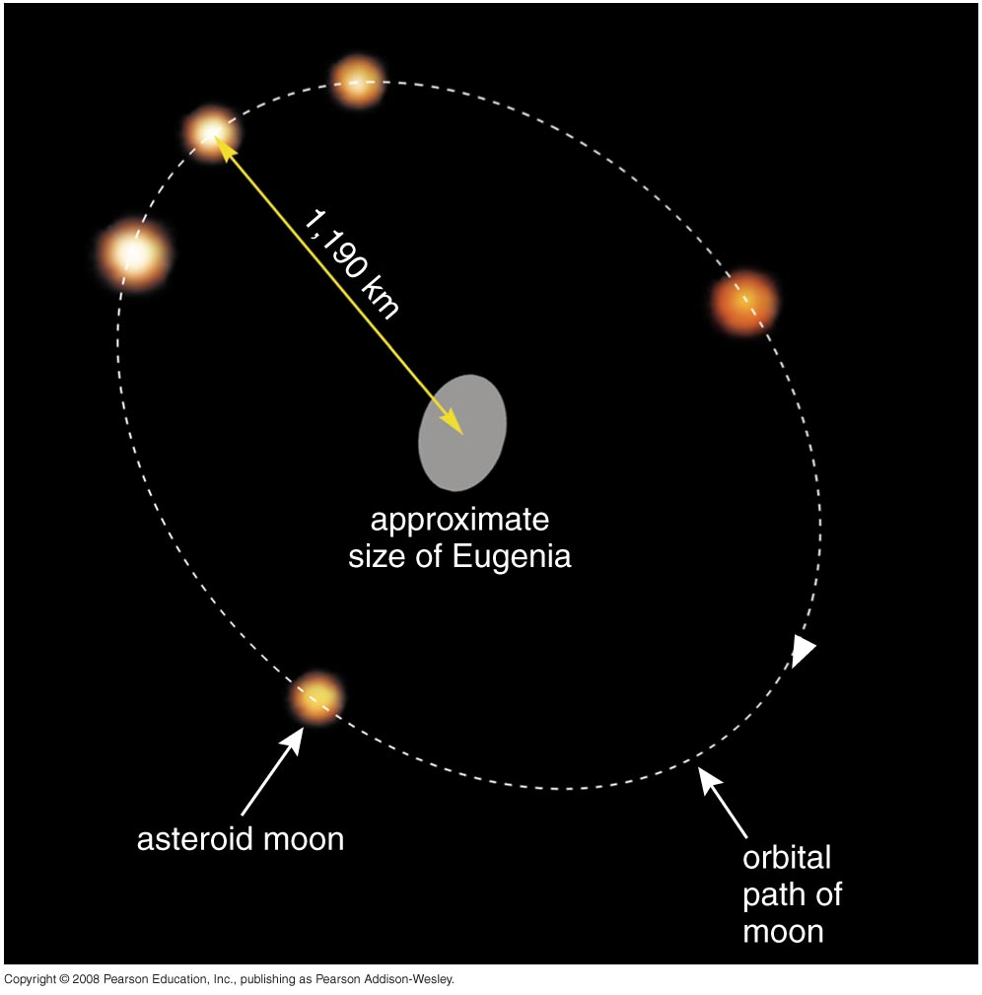
The few asteroid binaries analyzed so far are not very dense
Example: Eugenia
Made of carbonaceous material, should have high density
Yet measured density is only a bit higher than that of water!
Conclusion: Eugenia is a loosely bound pile of individual pieces, with cracks (“voids”) in between

Slide 19
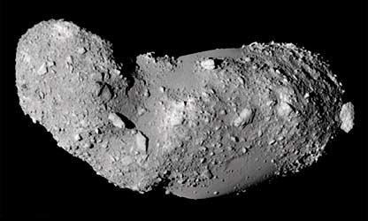
Asteroids: solid bodies vs. rubble piles?
Mathilde: solid Itokawa: rubble pile

Slide 20
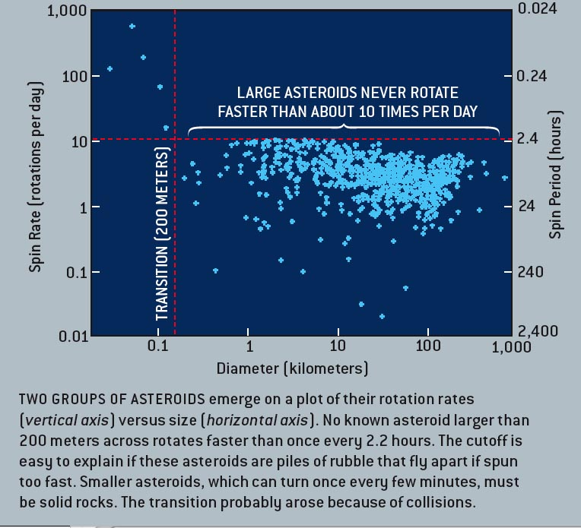
Source: E. Asphaug, Scientific American

Slide 21
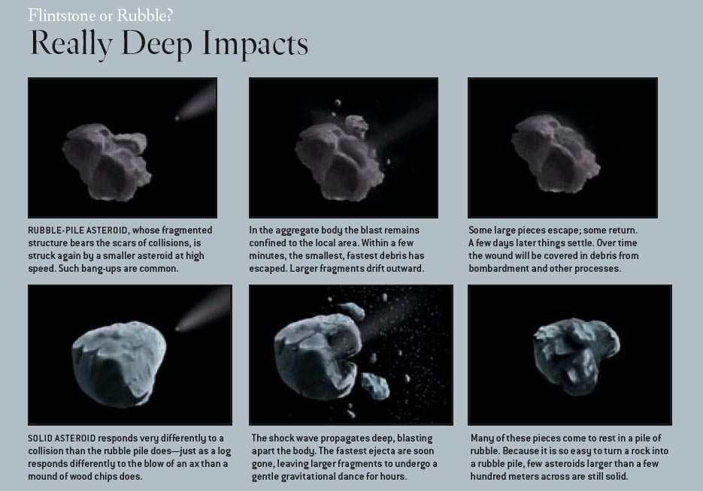
The life story of an asteroid?
Source: E. Asphaug, Scientific American

Slide 22
Is this an asteroid-asteroid collision?
Direction of Solar Wind

Slide 23
Differentiation in asteroids
Primitive, undifferentiated
Iron separates, sinks. Core forms.
Collisions expose iron core
Most asteroids were not heated beyond stage a)
Vesta reached stage b)
M and S type asteroids c) (M = metal)

Slide 24
Near Earth Asteroids: perturbed out of asteroid belt by Jupiter

Slide 25
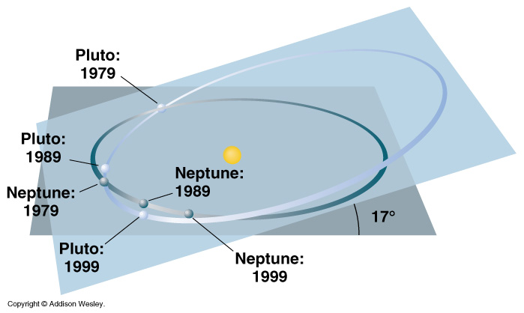
Pluto and Charon: orbit is elliptical, out of plane of rest of Solar System
Pluto wasn't discovered till 1930!

Slide 26
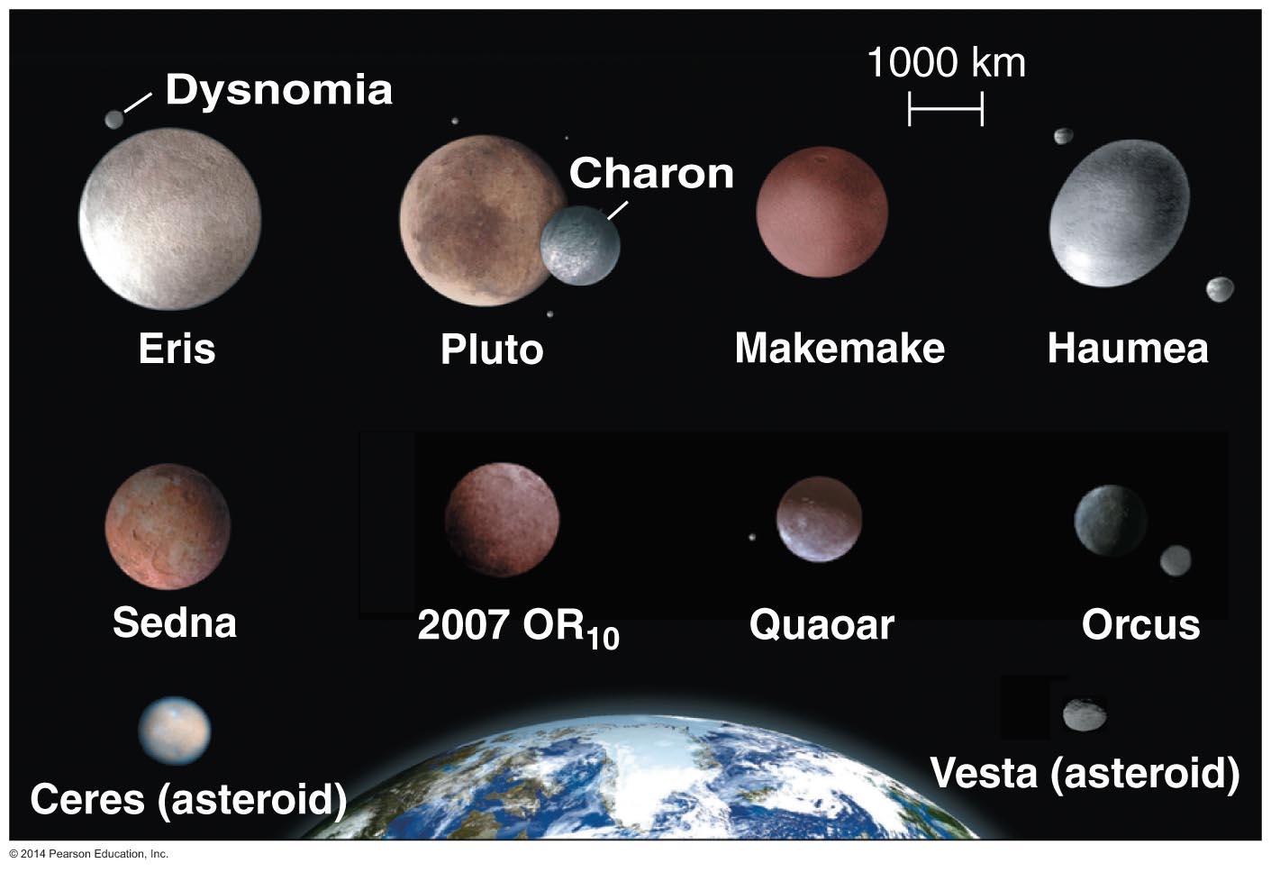
Other Pluto is not alone
There are many icy objects like Pluto on elliptical, inclined orbits beyond Neptune.
The largest of these, Eris, was discovered in summer 2005, and is even larger than Pluto.

Slide 27
Pluto and Charon
Pluto's avg density ~ 2 g/ cm³.
Pluto is 50% to 75% rock mixed with ices.
Charon's density is ~1.6 g/cm³, indicating it contains little rock.
Differences in density tell us that Pluto and Charon formed independently

Slide 28
Is Pluto just the largest Kuiper Belt Object?
Orbits in same vicinity as Kuiper Belt comets
Comet-like composition
Stable orbital resonance with Neptune, like many comets
But: Pluto is much more highly reflective
Perhaps ices that sublime when Pluto is closer to Sun stay with Pluto, and re-freeze on surface, whereas they are lost to less-massive comets.
One theory is that Charon was formed from Pluto in same way our Moon was formed from Earth mantle material

Slide 29
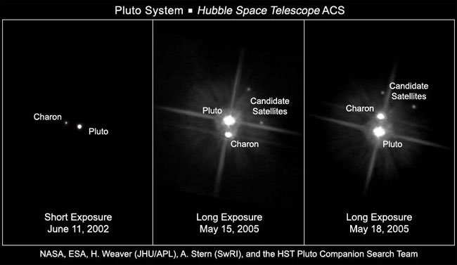
Hubble’s view of Pluto & its Moons

Slide 30
Other Kuiper Belt Objects
Most have been discovered very recently so little is known about them.
NASA’s New Horizons mission will study Pluto and a few other Kuiper belt object in a planned flyby.

Slide 31
Is Pluto a Planet?
By far the smallest planet
Pluto’s size was overestimated after its discovery in 1930
Not a gas giant like other outer planets
Has an icy composition like a comet
Has a very elliptical, inclined orbit
Pluto has more in common with comets than with the eight major planets

Slide 32
What is a planet?
International Astronomical Union meeting in Prague in 2006
Agreed that a "planet" is defined as a celestial body that
(a) is in orbit around the Sun
(b) has sufficient mass for its self-gravity to overcome rigid body forces so that it assumes a hydrostatic equilibrium (nearly round) shape, and
(c) has cleared the neighborhood around its orbit.
Slide credit: John Wilson, Georgia State U.

Slide 33
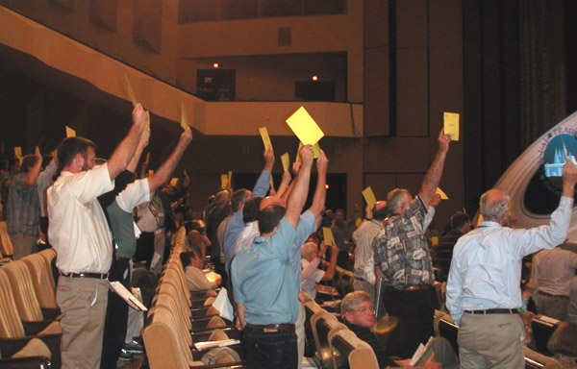
What is a planet?

Slide 34
What is Pluto? IAU decision, cont’d
Defined new class of objects called "dwarf planets"
“Planets" and "dwarf planets" are two distinct classes
First members of the "dwarf planet" category are Ceres, Pluto, Haumea, Makemake, and Eris
More "dwarf planets" are expected to be announced by the IAU in the coming years
Currently a dozen candidate "dwarf planets" are on IAU's "dwarf planet" watch list
Keeps changing as new objects are found
”Dwarf planet" Pluto is recognized as an important proto-type of a new class of trans-Neptunian objects
Slide credit: John Wilson, Georgia State U.

Slide 35
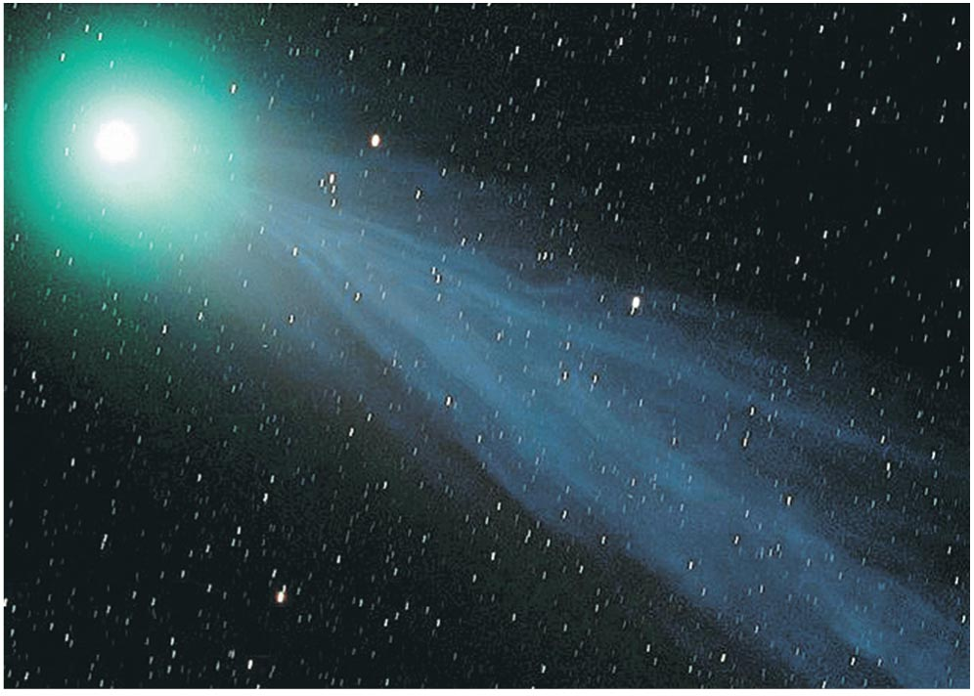
What are comets like?

Slide 36
Comet Facts
Nucleus of comet is a “dirty snowball” (ice mixed with with rock)
Most comets do not have tails
Most comets remain perpetually frozen in the outer solar system
Only comets that enter the inner solar system grow tails

Slide 37
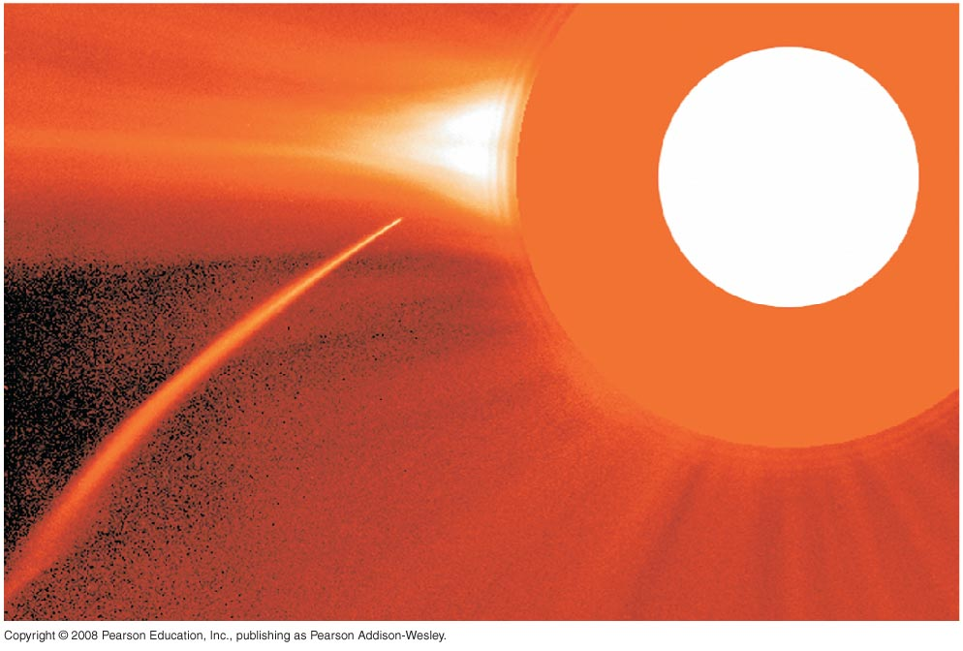
Sun-grazing Comet
Sun
Notes:
Simple rocks and metal, occasionally carbon compounds and water.
Shiny bits are metal flakes, first to condense.
White features are solidified dropletsof material that splashed out during impacts during accretion

Slide 38
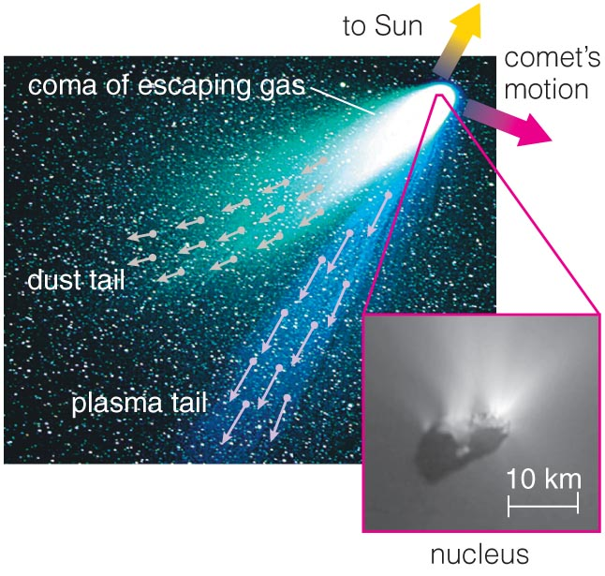
Anatomy of a Comet
Gas “coma” is atmosphere that comes from heated nucleus
Plasma tail is gas escaping from coma, pushed by solar wind
Dust tail is pushed by photons from the Sun

Slide 39
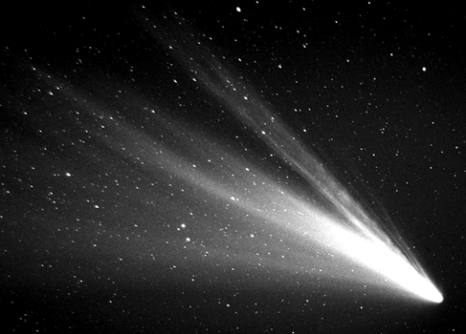
Length of comet tail is huge
Tail size many millions of km
By comparison, Jupiter is about 150,000 km in diameter

Slide 40
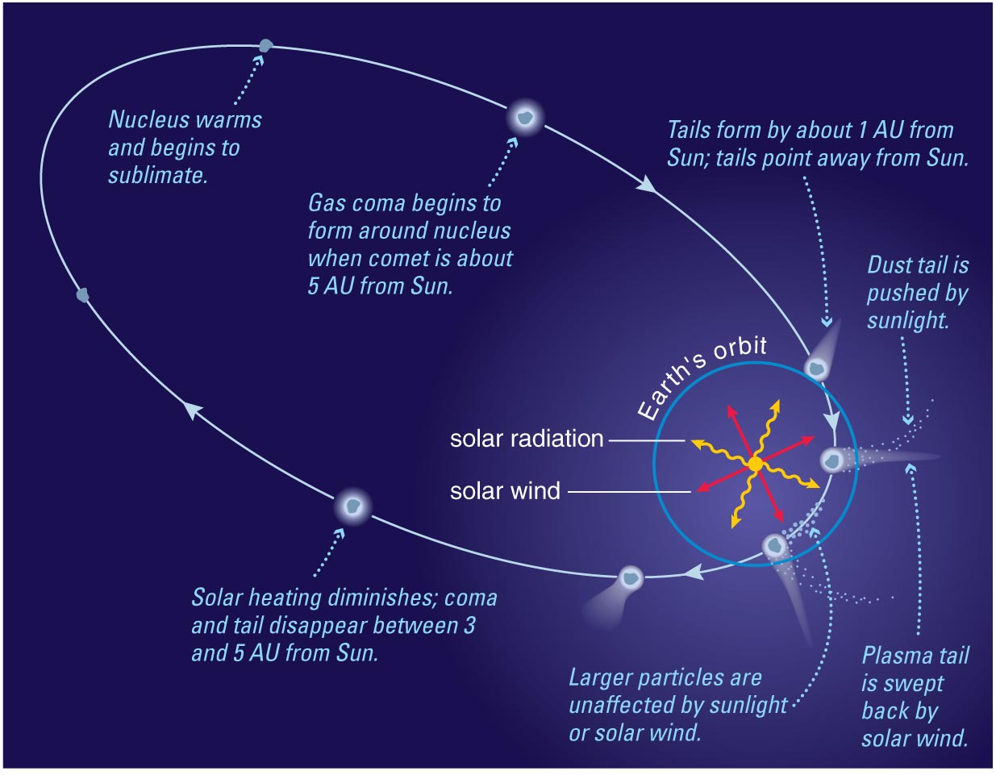
Tail grows as comet comes closer to Sun

Slide 41
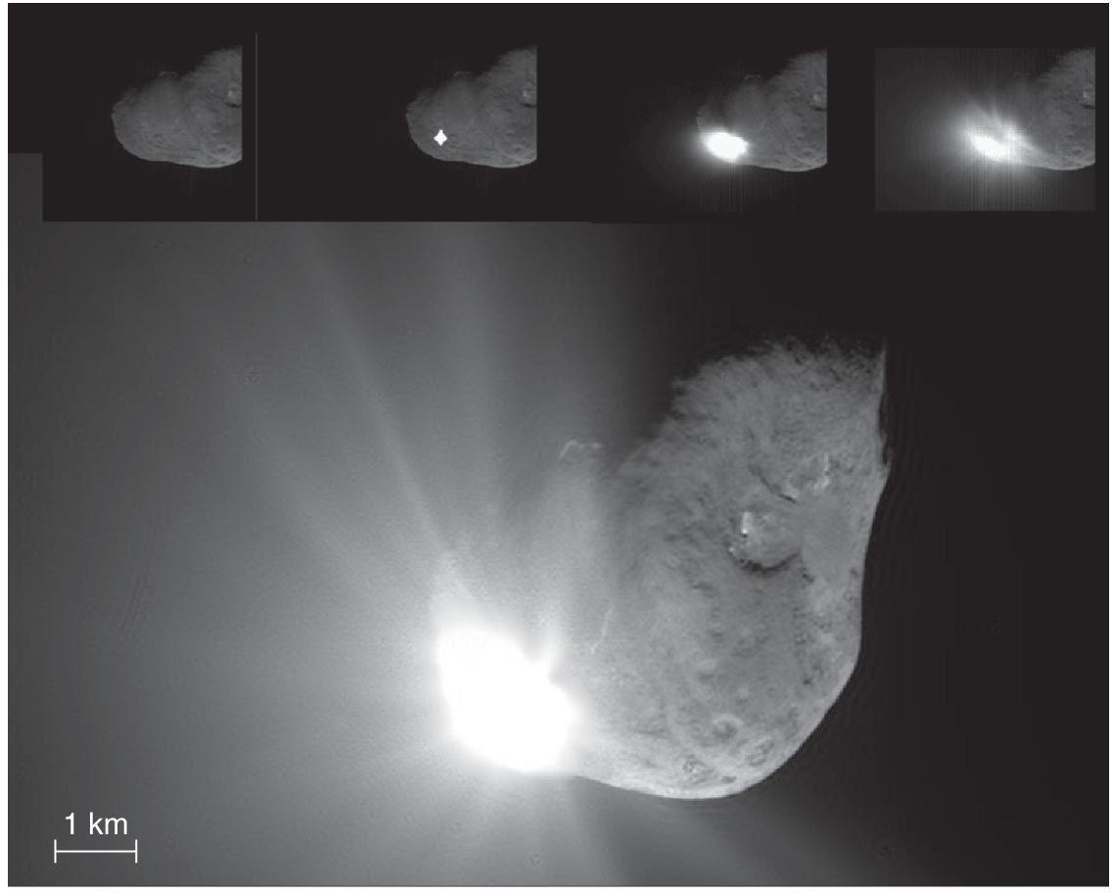
Deep Impact Spacecraft sent projectile into Comet Tempel 1
Mission to study nucleus of Comet Tempel 1
Projectile hit surface on July 4, 2005
Recorded by the “mother ship”
Many telescopes from Earth studied aftermath of impact

Slide 42
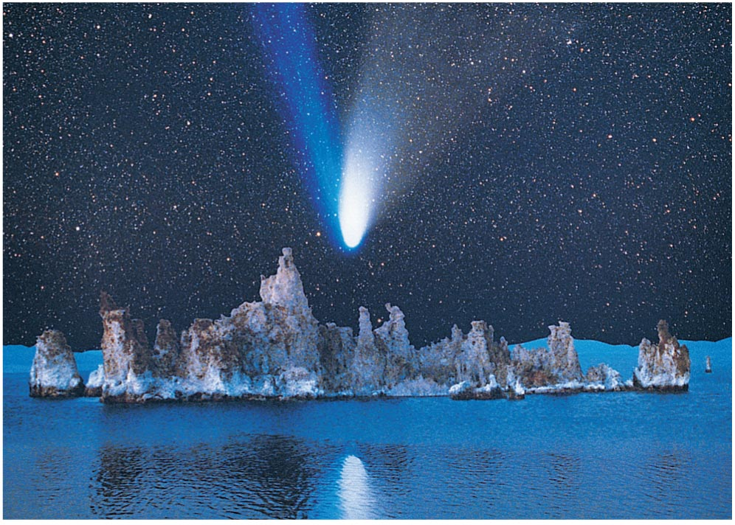
Where do comets come from?

Slide 43
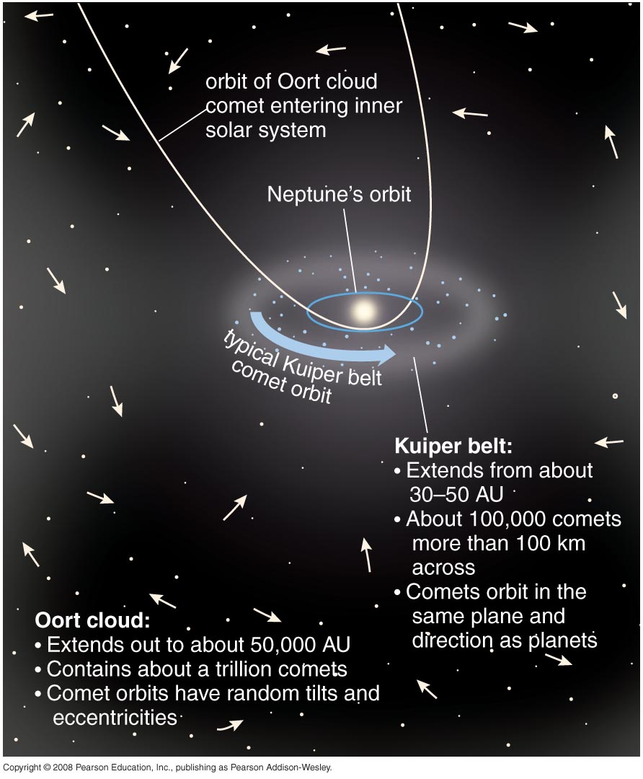
Few comets enter inner solar system
Oort cloud:
On random orbits extending to about 50,000 AU
Kuiper belt:
On orderly orbits from 30-100 AU in disk of solar system

Slide 44
How did they get there?
Kuiper belt comets formed in the Kuiper belt: flat plane, aligned with plane of Solar System, orbiting in same direction as the planets.
Oort cloud comets were once closer to the Sun, but they were kicked out there by gravitational interactions with jovian planets: spherical distribution, orbits in any direction.

Slide 45
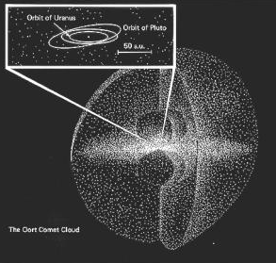
The Oort Cloud is almost spherical, well beyond orbit of Pluto
In 1950 Jan Oort noticed that
no comet orbit observed suggesting it came from interstellar space
strong tendency for aphelia of long period comet orbits to lie at distance ~ 50,000 AU
there is no preferential direction from which comets come.
He proposed that comets reside in a vast cloud at the outer reaches of the solar system
Up to a trillion comets in Oort cloud!

Slide 46
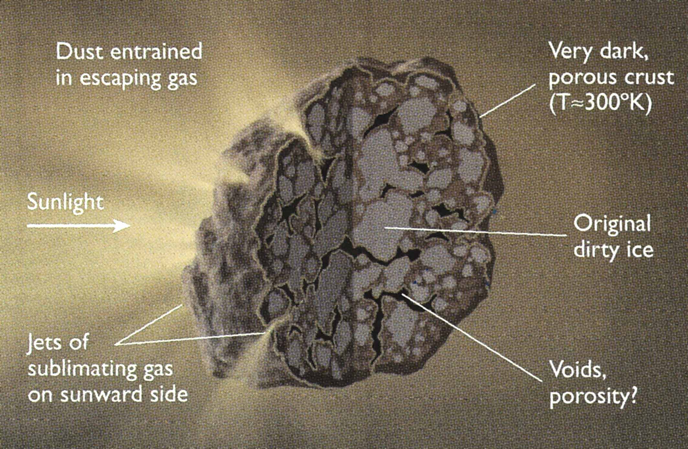
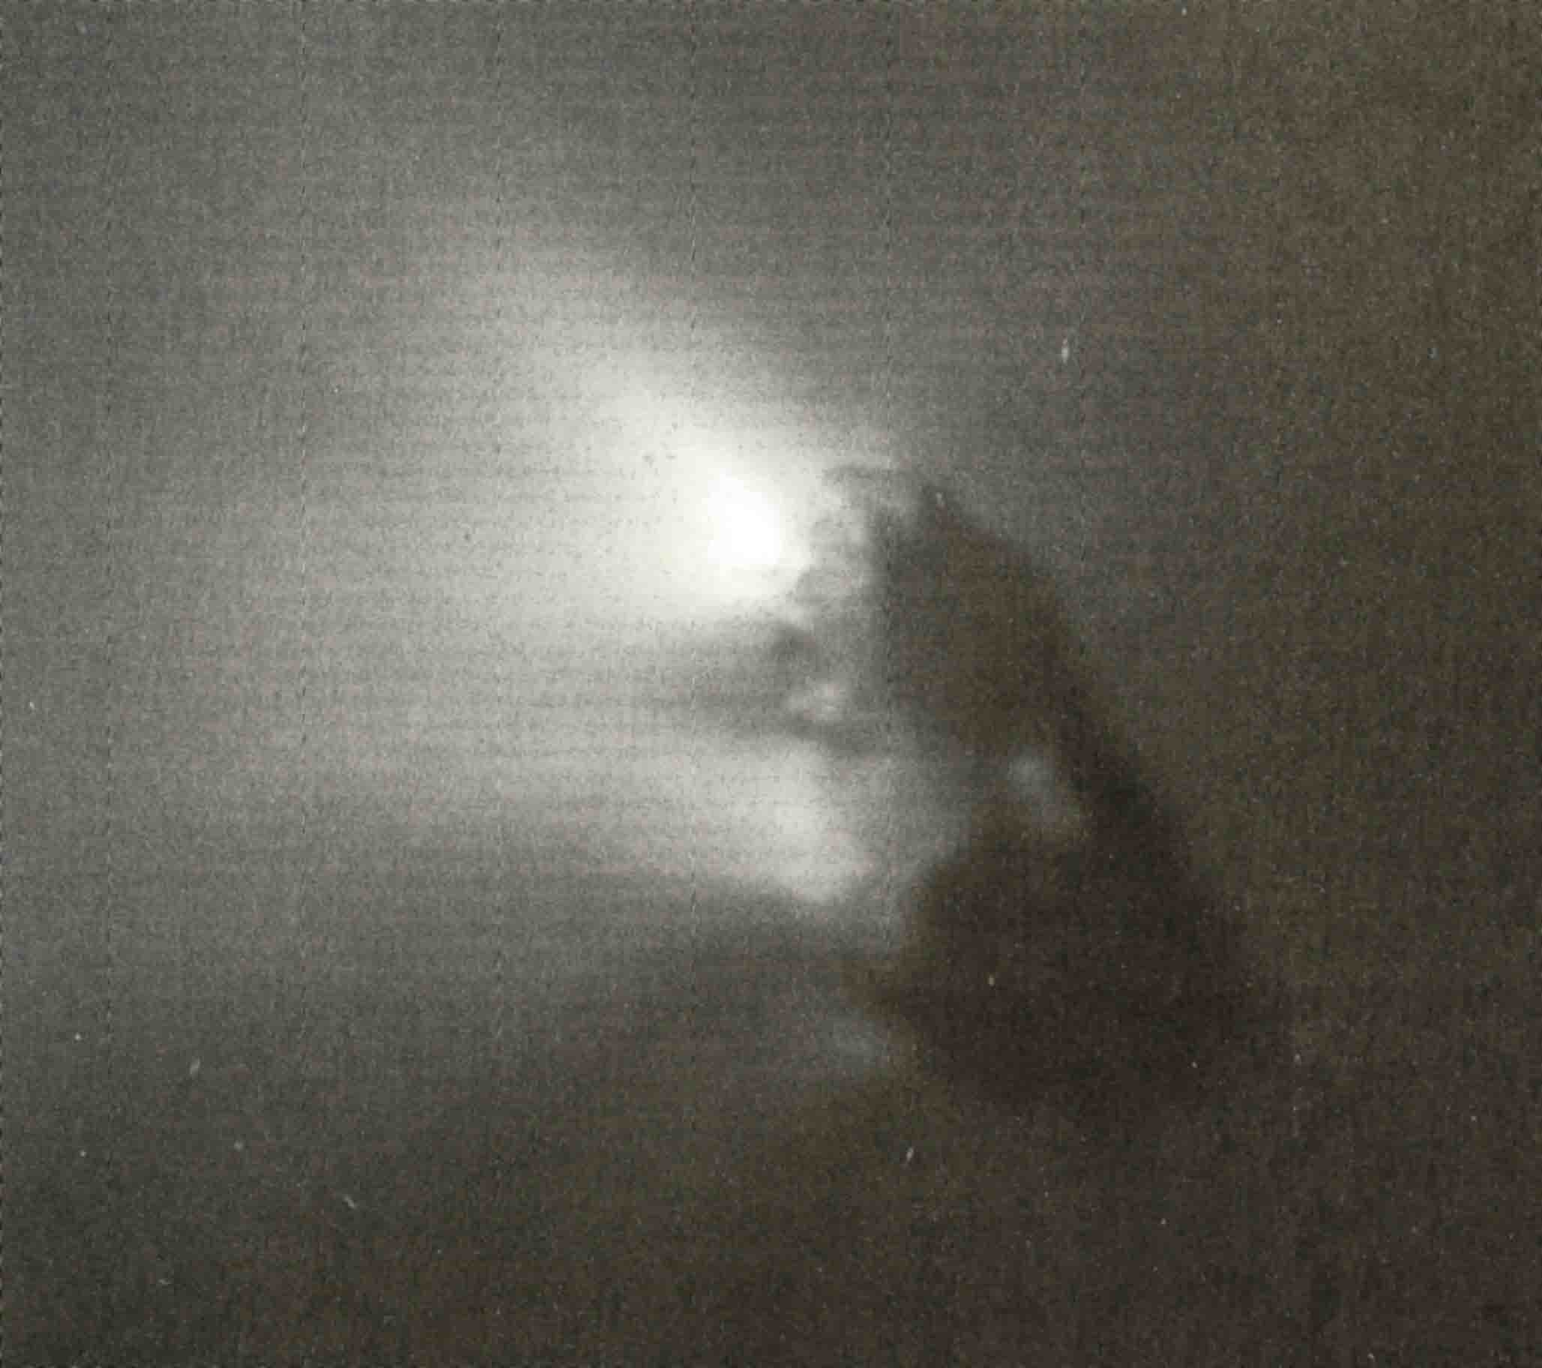
Comet nucleus
Nucleus of Halley’s Comet

Slide 47
Comet Hartley 1 seen from the EPOXI spacecraft

Slide 48
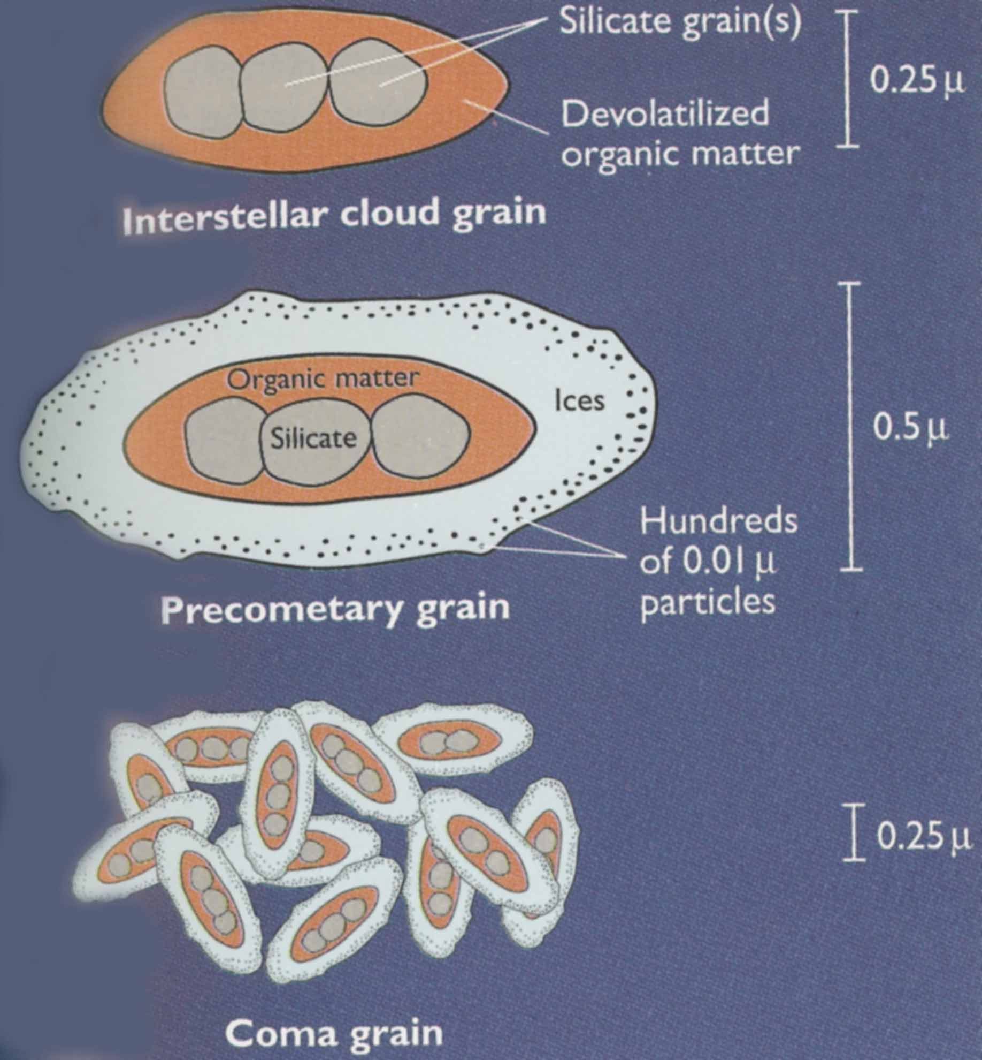
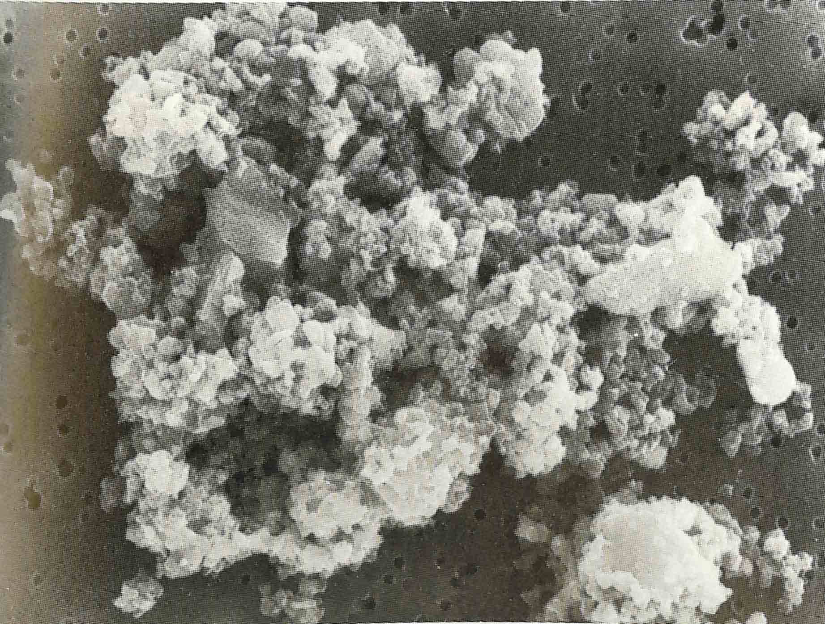
Dust is ejected from nucleus as it heats up, makes comet tail
Electron microscope image of dust

Slide 49
Concept Question
Remembering the division between the inner Solar System's rocky "terrestrial planets" and the outer Solar System's icy satellites, where in the Solar System might comets have originally formed?

Slide 50
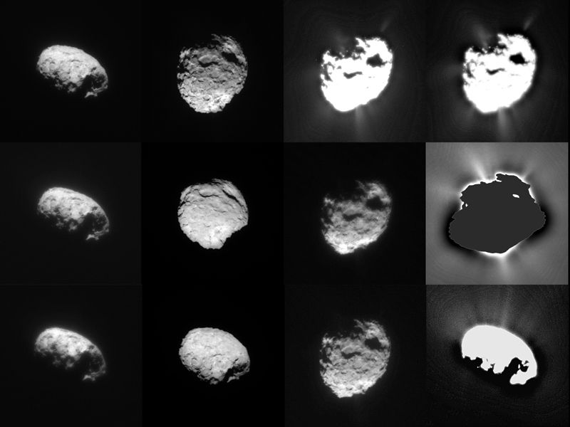
Stardust spacecraft flew to a comet, brought dust back to Earth
Stardust images of the nucleus

Slide 51
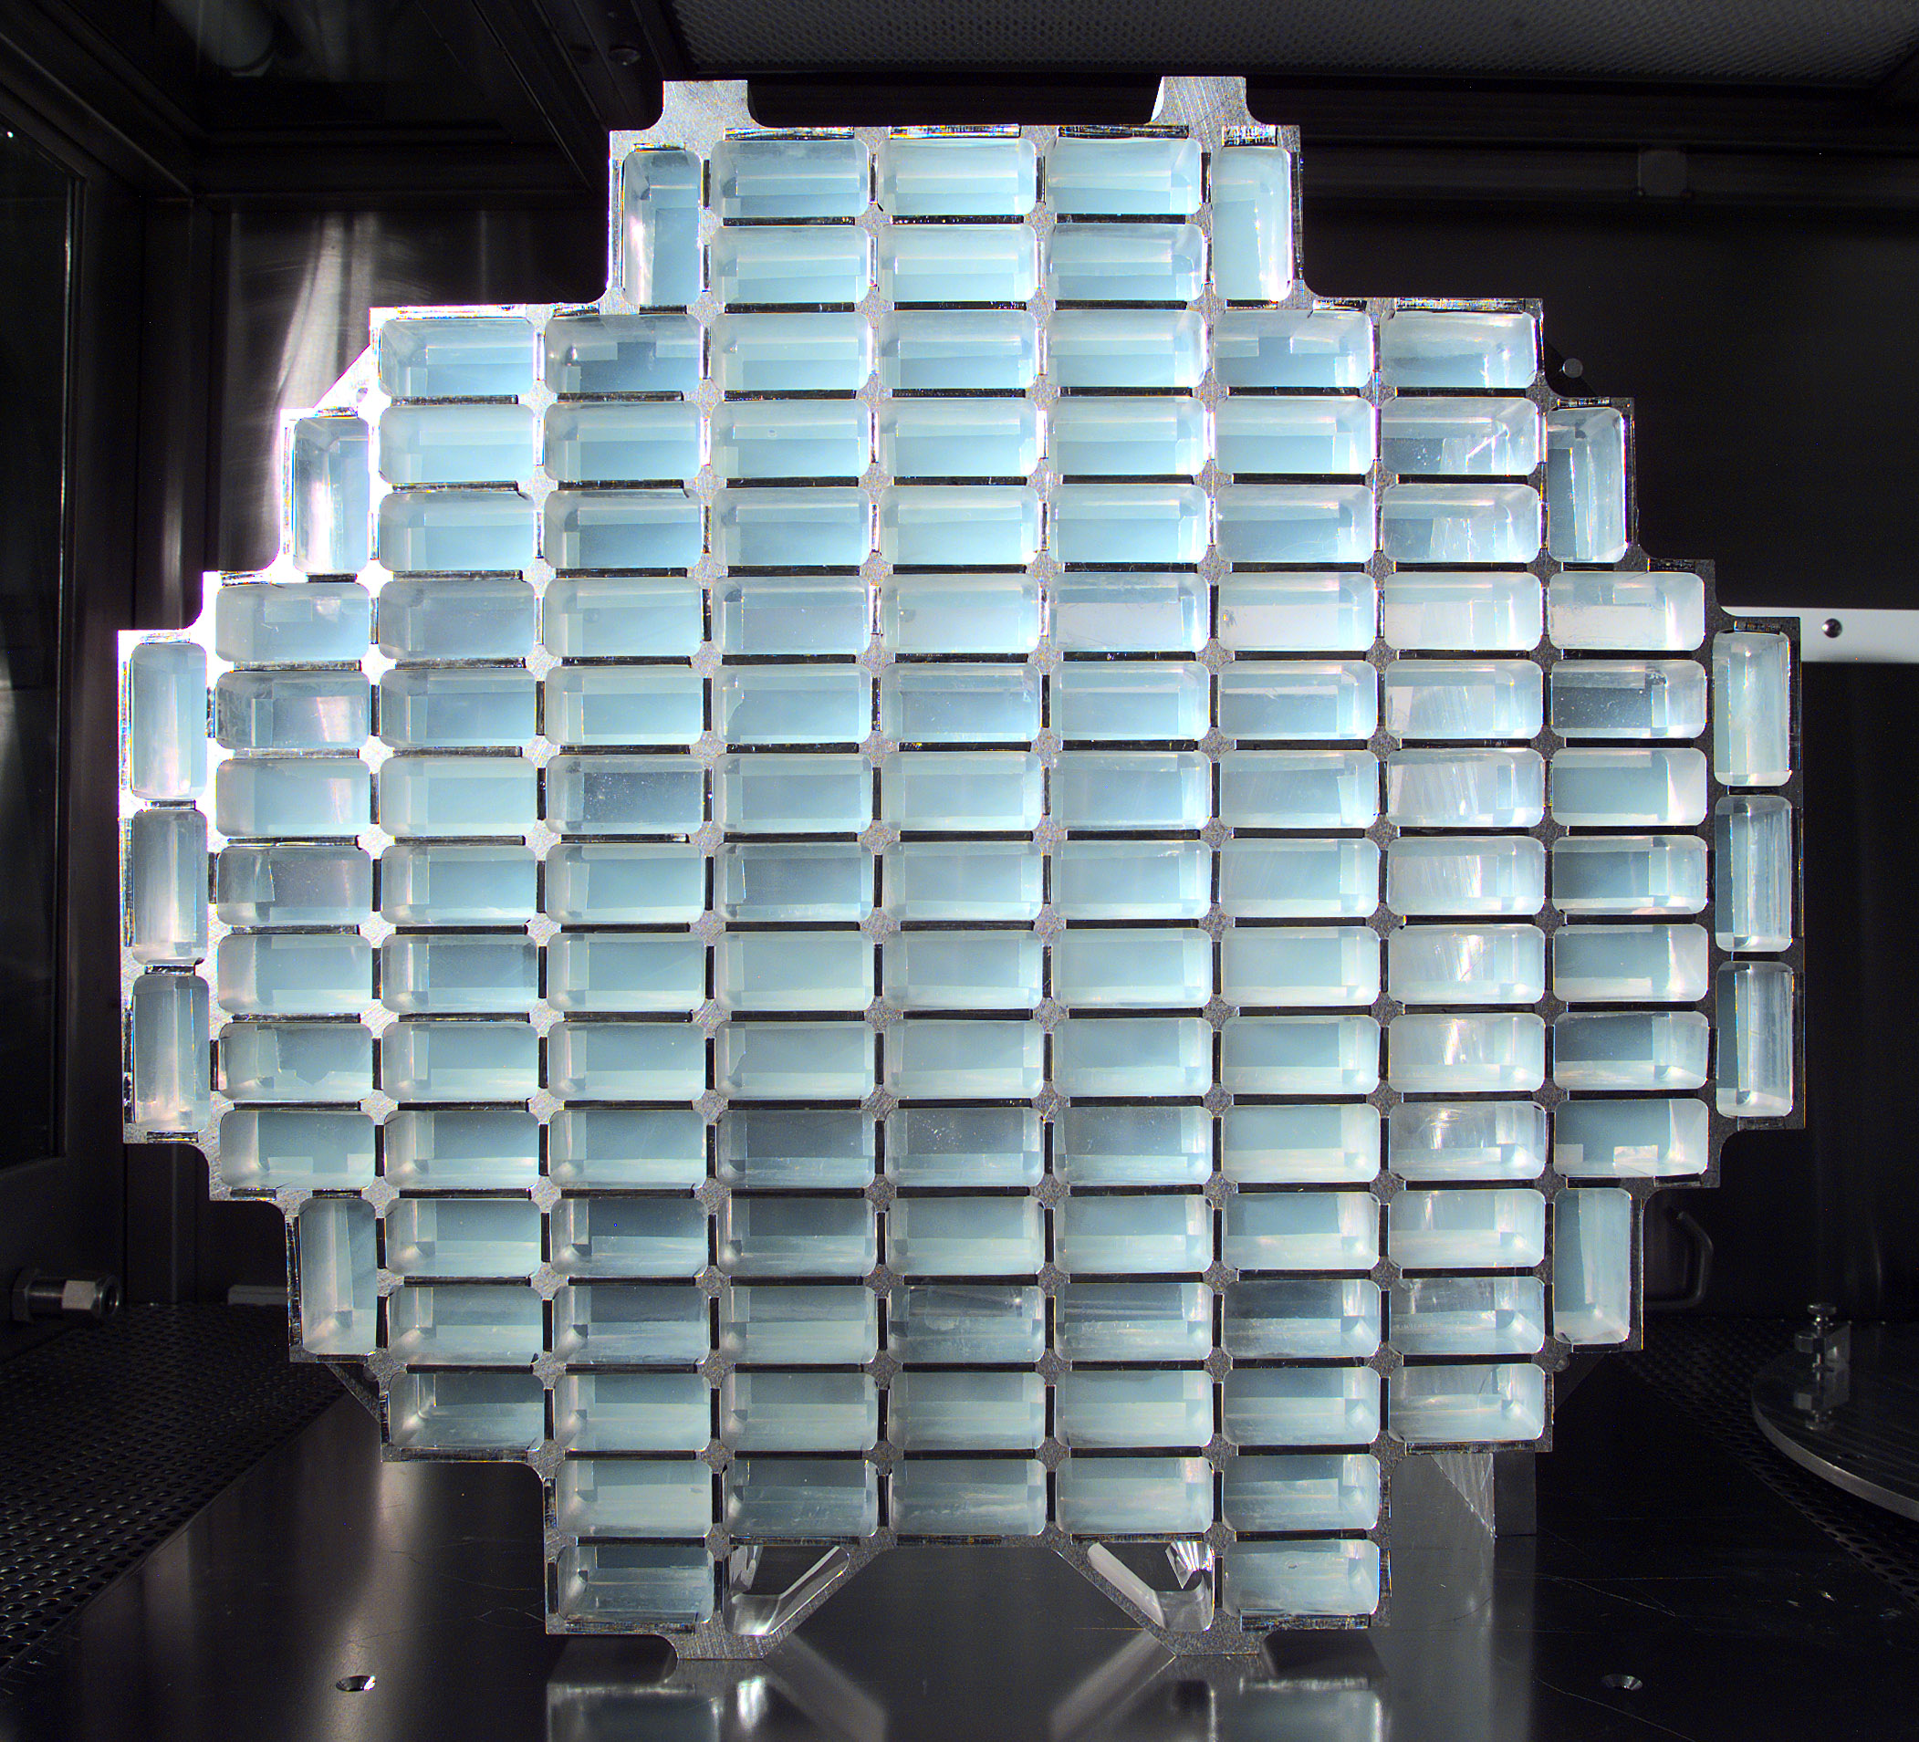
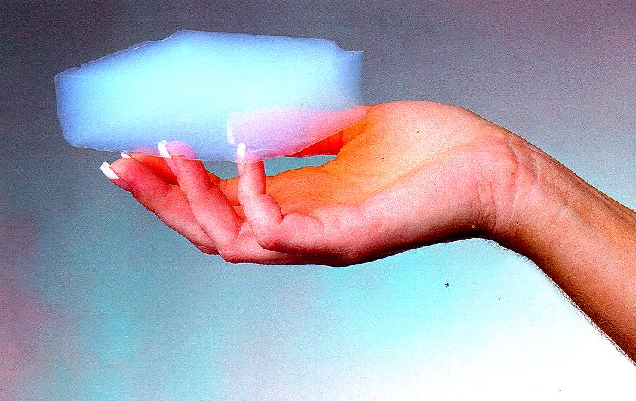
Stardust spacecraft, continued
Gathered cometary dust using aerogel targets
The least dense substance that is still solid
Brought back to Earth
Found that dust had been reprocessed in inner Solar System; identified Glycine (a building block of life)

Slide 52
The main points: Meteorites
Each year Earth sweeps up ~80,000 tons of extraterrestrial matter, from microscopic dust particles to large rocks
Some are identifiable pieces of the Moon, Mars, or Vesta; most are pieces of asteroids
Meteorites were broken off their parent bodies 10’s to 100’s of million years ago (recently compared to 4 Billion Years)
Oldest meteorites (chondrites) contain bits of interstellar dust, tiny diamonds made in supernova explosions, organic molecules and amino acids (building blocks of life), tiny spherules left over from the very early Solar System
Direct insight into solar system formation

Slide 53
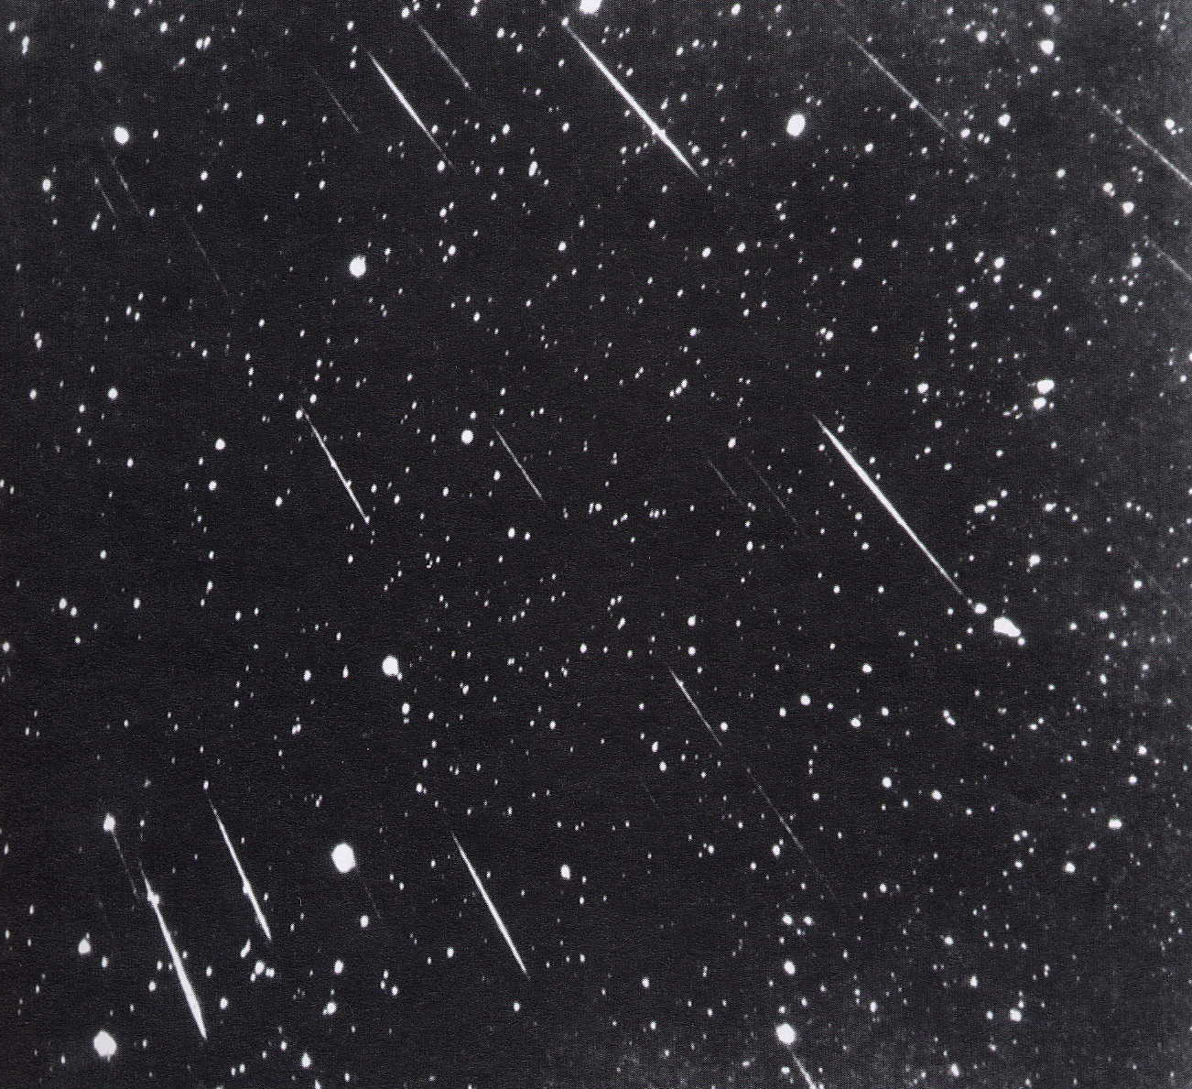
Meteor showers
Time exposure image, tracking stellar motion
Stars stay still, meteorites make trails

Slide 55
Rocks Falling from the Sky
meteor – a flash of light caused by a particle which enters Earth’s atmosphere.
most of these particles are the size of a pea or smaller
they completely burn up in Earth’s atmosphere
meteorite – a rock which is large enough to have survived its fall to Earth
they caused a brighter meteor…sometimes a fireball
How can you tell that you have a meteorite?
they have a higher metal content than terrestrial rocks
they contain Iridium and other isotopes not found in terrestrial rocks

Slide 56
What are meteorites?
Chunks of rock or iron-nickel that fall to Earth from space
Pieces of asteroids, comets, Moon, Mars, interstellar dust
Can weigh from < 1 ounce to a few tons (!)
“The Poor Man’s Space Probe”
From parts of the Solar System astronauts may never explore
Usually named after the place where they fall
Examples: Prairie Dog Creek (US), Zagora (Morocco), Campo del Cielo (Argentina), Mundrabilla (Australia)

Slide 57
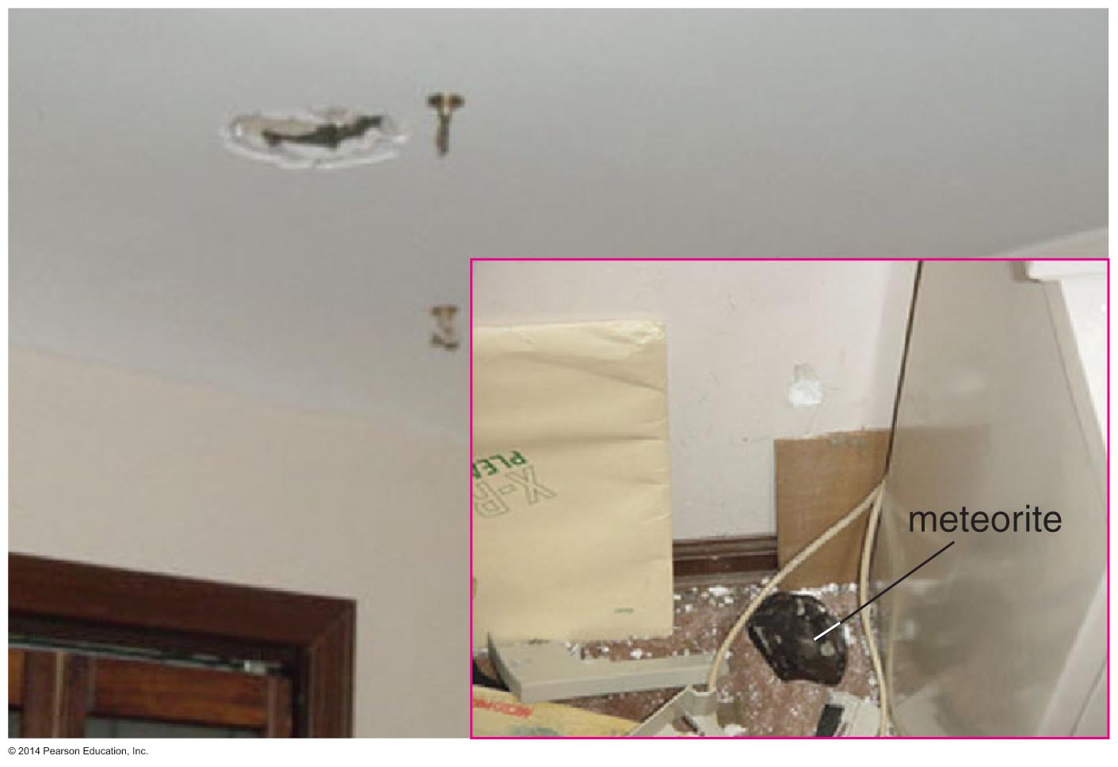
Meteorite Impact!
Chicago, March 26, 2003
Notes:
(note deleted)

Slide 58
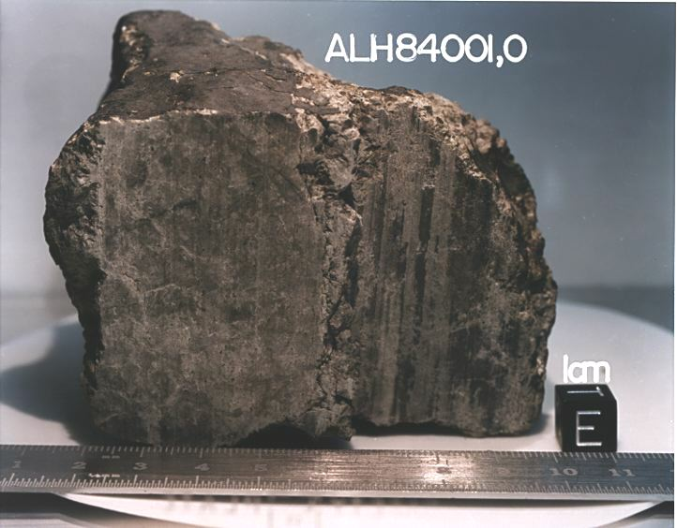
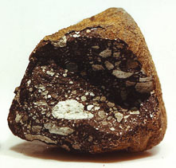
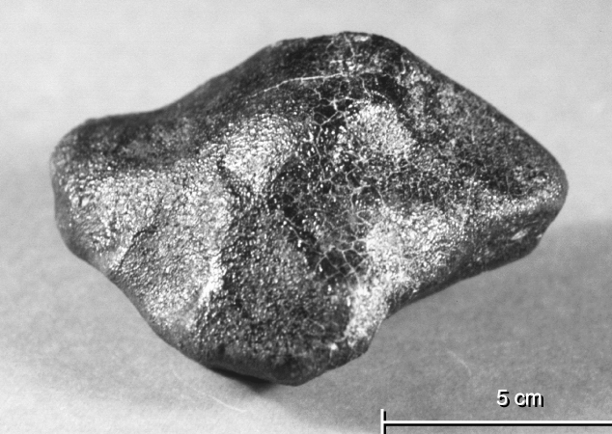
What do meteorites look like?
Vesta
Mars
meteorite
Allen Hills
(Moon)

Slide 59
Variety of meteorite “falls”
Tiny pieces of cosmic dust
Collected by special airplanes, in clay under the oceans, or in Antarctic ice
Find single small chunks of rock
Sometimes at random, sometimes by following trajectory of a “fireball” or meteor trail
A several-ton meteorite breaks up during descent, falls as separate pieces
Biggest pieces can make large craters if they hit land

Slide 60
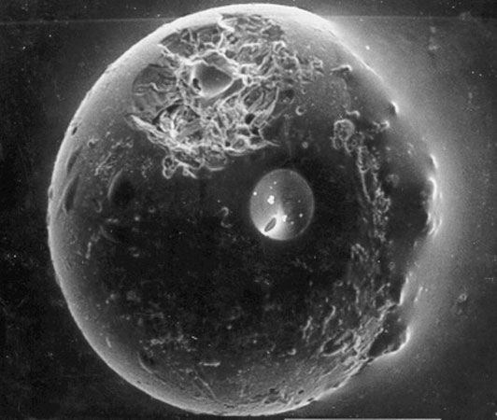
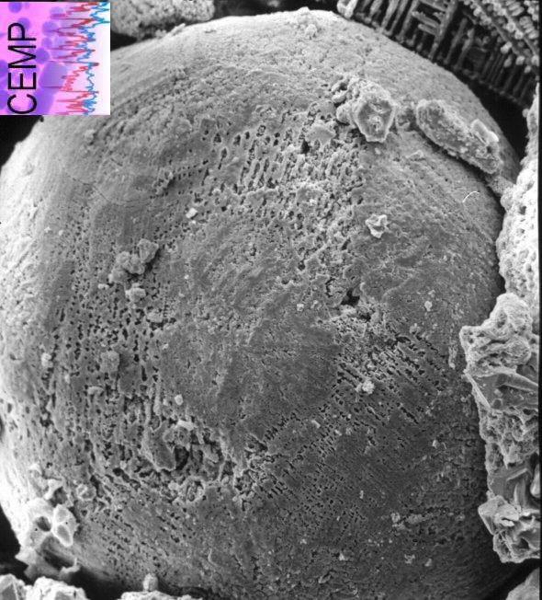
Small particles: spherules
Tiny droplets from space
Formed by melting and re-solidification after impacts
Spherule from Moon
Collected by Apollo 11 astronauts
Spherule
from bottom of the Indian Ocean

Slide 61
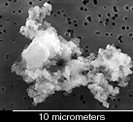
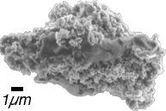
Small particles: cosmic dust
Sometimes from comets, sometimes left over from the cosmic dust cloud from which the Solar System formed

Slide 62
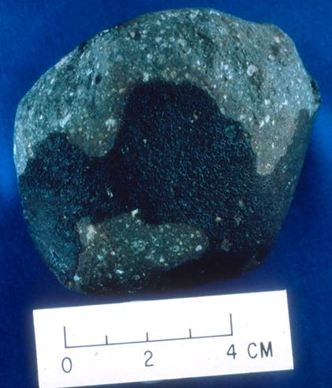
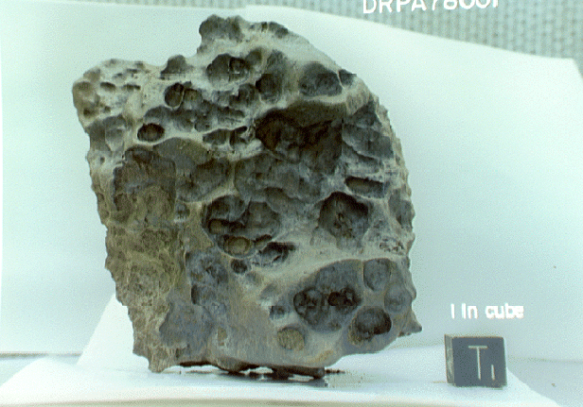
Single small chunks of rock
Iron-nickel meteorite
A few inches across
Allende
Carbonaceous chondrite

Slide 63
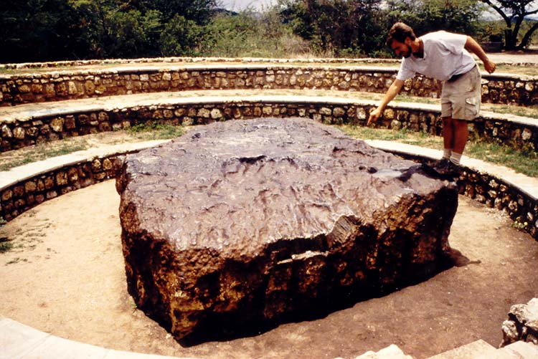
Several-ton boulders
Hoba Meteorite, Namibia

Slide 64
How dangerous are meteorites?

Slide 65
Worldwide frequency of meteorites as function of size
 | Impact Frequency
Size | Frequency | Destruction Area
Pea | 10/ hour
Walnut | 1/ hour
Grapefruit | 1/ 10 hours
Basketball | 1/ month
50 meters | 1/ century | New York City
1 kilometer | 1/ 100,000 years | Virginia
2 kilometers | 1/ 500,000 years | France
10 kilometers | 1/ 100 million years | World-Wide?

Slide 66
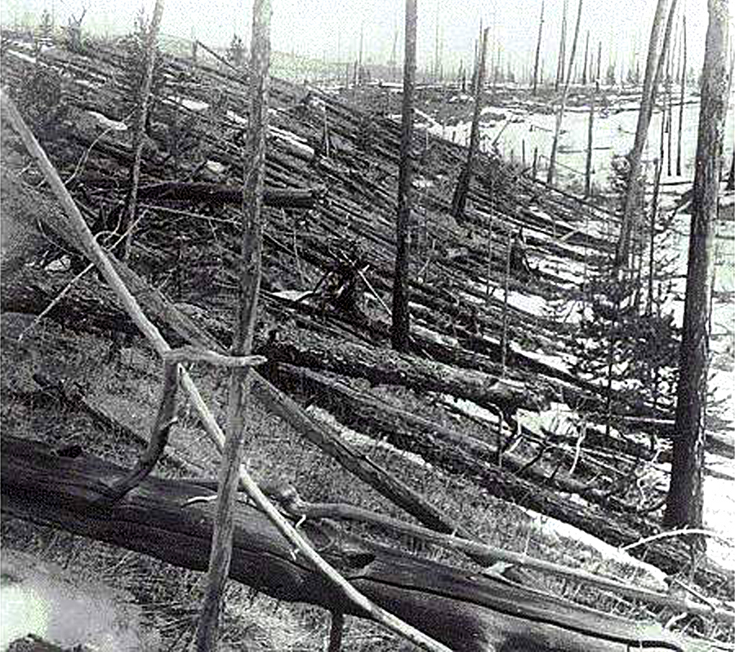
Tonguska meteorite in Siberia caused widespread devastation
Fortunately it hit in an unpopulated area!

Slide 67
How meteorites are found
Random “finds” lying on ground
Fragments around meteor craters
Follow glowing trail of meteor or fireball
Systematic searches in Antarctica
Special high-flying airplanes (for dust)

Slide 68
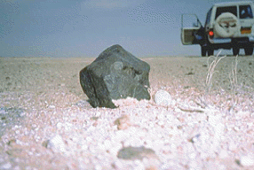
Random “finds”
Rare: a big meteorite in desert of Oman
Pretty rare: random “finds” of smaller chunks

Slide 69
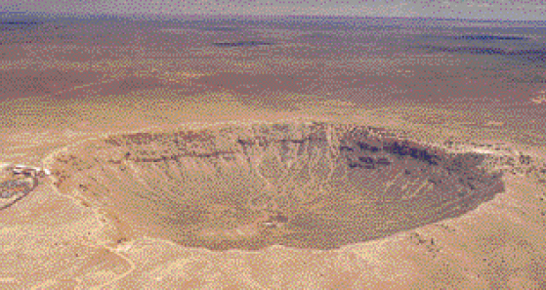
Fragments around meteor craters
Barringer Crater, Arizona
Very large meteorites vaporize when they hit ground, form big craters
Sometimes small pieces are found around crater

Slide 70
The Peekskill (NY) Fireball

Slide 71
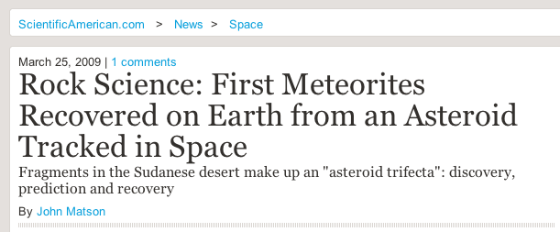
This year in Sudan....
Link to Scientific American article

Slide 72
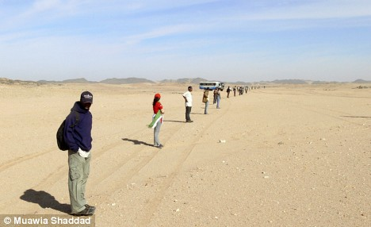
University of Khartoum students did systematic search
45 students and staff of the University of Khartoum rode buses out to desert, searched in lines. Found more than 280 pieces

Slide 73
University of Khartoum students did systematic search
45 students and staff of the University of Khartoum rode buses out to desert, searched in long lines. Found more than 280 pieces.

Slide 74
Macroscopic features of the Almahata Sitta meteorite.
P Jenniskens et al. Nature 458, 485-488 (2009)

Slide 75
Systematic searches in Antarctica

Slide 76
Systematic searches in Antarctica

Slide 77
Searching for rare meteorites amidst thousands of Earth-rocks

Slide 78
Primitive vs. processed meteorites
Based on composition, meteorites fall into two basic categories:
primitive
about 4.6 billion years old
accreted in the Solar nebula
processed
younger than 4.6 billion years
matter has differentiated
fragments of a larger object which processed the original Solar nebula material

Slide 79
Origin of Meteorites
Primitive meteorites condensed and accreted directly from the Solar nebula.
the stony ones formed closer than 3 AU from the Sun
the Carbon-rich ones formed beyond 3 AU from the Sun, where it was cold enough for Carbon compounds to condense
Processed meteorites come from large objects in the inner Solar System.
the metallic ones are fragments of the cores of asteroids which were shattered in collisions
the rocky ones were chipped off the surfaces of asteroids, Mars, and the Moon by impacts

Slide 80
Main types of meteorites
Chondrites
Carbonaceous
Non-carbonaceous
Achondrites
Iron
Stony-Iron

Slide 81
Chondrites
Rocky, inhomogeneous, contain round “chondrules”

Slide 82
Carbonaceous Chondrites contain complex organic molecules
Amino acids, fatty acids, other so-called “building blocks of life”
Did building blocks of life come to Earth from space?
Did life itself come to Earth from space?
“Panspermia” theory

Slide 83
Carbonaceous Chondrites: Insights into Planet Formation?
The oldest meteorites; quite rare
Chondrules (round): primitive chunks of early Solar System
Calcium aluminum inclusions (CaI’s): isotope ratios (26 Al and 26 Mg) suggest that a supernova explosion went off right next to the early Solar Nebula
Did the supernova stimulate formation of our Solar System?

Slide 84
Some types of Chondrites were formed all at once: from one asteroid

Slide 85
Iron meteorites
Made of iron and nickel
Pits made during atmospheric entry (hot!)

Slide 86
Iron meteorites: from core of differentiated asteroids

Slide 87
The making of future meteorites!

Slide 88
Crystalization pattern of the iron is unique
Characteristic of very slow cooling of iron within an asteroid core
Due to diffusion of nickel atoms into solid iron as core cools
Says original asteroid must have been large enough to be differentiated

Slide 89
Stony-Iron meteorites - the prettiest
Crystals of olivene (a rock mineral) embedded in iron
From boundary between core and mantel of large asteroids?

Slide 90
Achondrites: from Mars and Moon
From Mars:
Tiny inclusions have same elements and isotope ratios as Martian atmosphere (measured by spacecraft on Mars)
From the Moon:
Astronauts brought back rocks from several regions on the Moon
Some achondrites match these rock types exactly

Slide 91
Where do meteorites come from, and how do we know?
Spectra: reflection of sunlight as function of wavelength of light
Spectra of some meteorites and asteroids can be identical
Implies asteroid was parent body
Toro

Slide 92
The main points: Meteorites
Each year the Earth sweeps up ~80,000 tons of extraterrestrial matter
Some are identifiable pieces of the Moon, Mars, or Vesta; most are pieces of asteroids
Meteorites were broken off their parent bodies 10’s to 100’s of million years ago (recently compared to age of Solar System)
Oldest meteorites (chondrites) contain interstellar dust, tiny diamonds made in supernova explosions, organic molecules and amino acids (building blocks of life)
Direct insight into pre-solar system matter, solar system formation

Slide 93
The main points: Cosmic Collisions
Cosmic collisions played major role in Solar System evolution
Aggregation of planets from planetesimals
Formation of Moon, tilt of Venus’ and Uranus’ rotation axes, composition of Mercury
Also played a major role in Earth’s evolution
Tilt of axis
Mass extinctions (dinosaurs, others)
Collision history derived from crater patterns, isotope ratios
Probability of global catastrophic impact event once every 100 million years
Strong interest in tracking all Near-Earth Objects (NEO’s) that might hit the Earth in the future

Slide 94
Role of cosmic collisions in evolution of Solar System
Early phase (4.5 billion yrs ago): planet formation
Planetesimals collided or accreted to form larger pieces
Formation of Moon by glancing collision with Earth
Removal of most of Mercury’s crust by collision
Collision made Venus rotate backwards
Collision tipped Uranus onto its side (now rotates at 90 deg to rotation axes of all other planets)
“Late Heavy Bombardment” (~3.9 billion years ago) from Lunar record
First signs of life on Earth immediately followed “Late Heavy Bombardment” period. Is there some sort of causal connection?

Slide 95
Early phase (4.5 billion yrs ago): planet formation relies on collisions

Slide 96
Evidence that Moon formed as result of a collision
Earth has large iron core, but the moon does not
Earth's iron had already drained into the core by the time of the giant impact that formed the moon
Debris blown out of both Earth and the impactor came from their iron-depleted, rocky mantles
Explains why mean density of Moon (3.3 grams/cm³) is much less than Earth (5.5 grams/cm³)
Moon has same oxygen isotope composition as the Earth
Mars and meteorites from outer Solar System have different oxygen isotope compositions
Moon formed form material formed in Earth's neighborhood.

Slide 97
Formation of the Moon….
Large planetesimal collides w/ Earth at glancing angle
Removed material is from mantle of Earth

Slide 98
Uranus’ rotation axis lies in plane of its orbit
Unique in Solar System
All other planets’ rotation axes point out of the plane of their orbits

Slide 99
Collision with a massive body is best way to explain this
Would have to have collided with a body at least as big as the Earth
Approached Uranus at a large angle to the plane of the Solar System

Slide 100
Theories suggest young outer solar system was very unstable place
Many tens of Uranus and Neptune-mass planets initially
Unstable orbits: most of them were ejected from solar system
Perhaps on the way out, one of them hit Uranus

Slide 101
Venus rotates “backwards” compared with all other planets
Did two roughly equal-mass bodies merge to form Venus? Was early Venus hit by another planetary object?

Slide 102
Removal of most of Mercury’s crust by collision
Theory developed to explain why Mercury has so little lithosphere compared with its core

Slide 103
The Moon

Slide 104
“Late Heavy Bombardment” of Moon
Evidence from Moon suggests impact rate was 1000 times higher 4 billion years ago than 3.8 billion years ago
Heavy bombardment of Moon slowed down about 3.8 billion years ago
Similar evidence from Mercury, Mars

Slide 105
Evolution of the Moon’s Appearance
"Mare" are huge lava flows that came from fissures in Moon’s crust 3.2-3.9 billion years ago. There are similar flows on Earth (Siberia, India).
Even during heavy bombardment, a major impact only occurred every few thousand years. Now they only occur over tens or hundreds of millions of years (so the lunar surface hasn’t changed too much).

Slide 106
Basins on Mercury, Moon, Mars

Slide 107
How general was the "late heavy bombardment" ?
If Moon, Mars, Mercury all were hit, probably the Earth was too
Was it the “last gasp” of planetary accretion? Or a real spike in impact rate?

Slide 108
How general was the "late heavy bombardment" ?
If Moon, Mars, Mercury all were hit, probably the Earth was too
Was it the “last gasp” of planetary accretion? Or a real spike in impact rate?

Slide 109
One theory: a real spike in impacts
Initially Solar System had large population of icy objects beyond Saturn
In stable orbits around Sun for several hundred million years until Neptune and Uranus began to form
As these planets grew, their gravitational attraction began to scatter the remaining planetesimals into the inner Solar System
A small fraction crashed into the Moon and rocky planets, making immense craters
Calculations suggest that the bombardment would have lasted less than 100 million years
Consistent with ages of craters and impact basins in Lunar highlands

Slide 110
Earth experienced major collisions as well
But most craters got eroded away, subducted, or drowned
A tour of craters on Earth:
Algeria Chad (Africa) from airplane

Slide 111
Earth’s craters
Clearwater, Canada Henbury, Australia

Slide 112
Earth’s craters, continued
Tswaing, South Africa
New Quebec, Canada

Slide 113
Arizona’s Meteor Crater, the most famous example

Slide 114
Giant impact 64 million years ago: best idea for dinosaur extinction
Chicxulub crater north of Yucatan peninsula, Mexico
180 km wide
Dated to same period as extinctions at Cretacious-Tertiary boundary

Slide 115
Corroborating evidence: Iridium layer
Layer of enhanced abundance of Iridium found worldwide
Dated to same time as dinosaur impact
Asteroids contain high concentration of Iridium, relative to Earth
Ash on top of Iridium (huge fires)

Slide 116
Impact energies are very large!
Credit: Bob O’Connell, U Virginia

Slide 117
BBC News, 2002: Evidence for Late Heavy Bombardment on Earth
OUR PLANET WAS BEATEN UP
The first convincing evidence that the Earth was bombarded by a devastating storm of meteoroids and asteroids four billion years ago has been found in Earth's oldest rocks.
Scientists have looked for clues in sedimentary rocks from Greenland and Canada - the oldest on Earth - that date from the waning phases of the Late Heavy Bombardment.
Researchers from the University of Queensland, Australia, and the University of Oxford, UK, say they have detected in these rocks the chemical fingerprints of the meteorites left over from the Late Heavy Bombardment - various types of tungsten atoms (tungsten isotopes) that must be extraterrestrial.

Slide 118
Collision of Comet Shoemaker-Levy 9 with Jupiter, 1994
Comet discovered March 1993, after it was captured into orbit around Jupiter
In 21 separate pieces! Broke up due to Jupiter’s tidal forces
All 21 fragments hit Jupiter in one week in July 1994

Slide 119
Tidal breakup of a comet when it passes too close to Jupiter

Slide 120
Worldwide network of astronomers observed collisions over one week
I was at Lick Observatory on Mt Hamilton
As Earth turned, e-mails flew around the planet to tell people what to look for
As Jupiter was setting at one place on Earth, scientists sent e-mails to places where Jupiter was just rising
Examples: “Impact B is a dud” “Impact G is spectacular”

Slide 121
Initial impact with atmosphere on night side, seen by Galileo spacecraft
Time sequence
White dots are hot gases exploding out of Jupiter’s atmosphere on night side

Slide 122
G impact spot as Jupiter rotated (Lick Observatory)

Slide 123
Multiple fragments of Shoemaker-Levy 9 hit Jupiter in sequence
Infrared image of multiple impact points
(Keck Telescope)
Hubble Space Telescope visible-light image

Slide 124
Lessons learned from Comet Shoemaker-Levy 9
Made us realize that “impacts happen” !
Many comets must break up into pieces the way SL-9 did: Ganymede craters

Slide 125
The asteroid with our name on it
We haven't seen it yet.
Deflection is more probable with years of advance warning.
Control is critical: Breaking a big asteroid into a bunch of little asteroids is unlikely to help.
We get less advance warning of a killer comet….

Slide 126
What if a Shoemaker-Levy 9 size comet were to hit the Earth?

Slide 127
Drastic effects of impact on a terrestrial planet
At “ground zero” rock, water, biomass are vaporized or melted
Deeper rock is shock recrystallized (ultra high pressures) and fractured
Series of deep fractures form, may allow lava from the interior to erupt
Shockwaves obliterate life just outside of “ground zero”
Earthquakes (and impact itself, if in ocean) generate giant waves in oceans, wipe out coastal areas
Friction in atmospheric dust generates widespread lightening
Thick dust in atmosphere blots out sun for months or years
Aerosols caused by eruptions and vaporization remain in atmosphere for decades

Slide 128
Future extinctions might not be limited to dinosaurs

Slide 129
Near Earth Objects: will Earth have another collision soon?

Slide 130
There have been many impacts in the past

Slide 131
What can be done?
Vigorous program to detect objects that are aiming near Earth
Several are under way; not as vigorous as they might be
Also need better orbit prediction methods
Characterize mechanical properties of the main types of asteroids, comets
Are they solid? Rubble piles? Makes a difference.
Work on conceptual ways to divert an incoming object
Gentle (ion thruster for 50 yrs)
Not so gentle (e.g. nuclear blast, ….)
Solar radiation pressure? (paint one side white!)

Slide 132
There are several projects to find near Earth asteroids and comets
It is thought that there are about 1600 Earth crossing asteroids larger than 1 km in diameter.
Only about 100 are known.
Programs to find most of them are under way
Still somewhat of a hard sell to funding agencies

Slide 133
Question
If one of the Near Earth Object programs finds an incoming asteroid that will likely hit the Earth, should they announce it to the public?

Slide 135
Low probability of a rare but high-consequence event

Slide 136
Cosmic Collisions: The main points
Cosmic collisions played major role in Solar System evolution
Aggregation of planets from planetesimals
Formation of Moon, tilt of Uranus’ axis, composition of Mercury
Also played a major role in Earth’s evolution
Tilt of axis
Mass extinctions (dinosaurs, others)
Collision history derived from crater patterns, isotope ratios
Probability of global catastrophic impact once every 100 million years; regional catastrophic events more frequent
Recent advances in tracking all Near-Earth Objects (NEO’s)
Very active field of research!
Probability is 100% that a Near Earth Object will hit us. The big questions are "how soon?" and "what can we do about it?"

